Slide 1
Micro-frontend via Webpack 5 Module Fédération

Slide 2




Votre hôte
@DedieuS
Sylvain DEDIEU
https://github.com/sdedieu
Domaines d’expertise
Angular - Vue - AnularJS - Ionic - Flutter - Firebase - Node - React
sylvain.dedieu@kaizen-solutions.net

Slide 3


Manfred the man
@ManfredSteyer
https://github.com/manfredsteyer
Lien

Slide 4
Architecture Monolithique
Couche de persistance
Database
Couche API
Couche Frontend
</>
Schéma tiré du livre Building Micro-frontends – Luca Mezzalira

Slide 5
Vers une Architecture Microservice

Slide 6

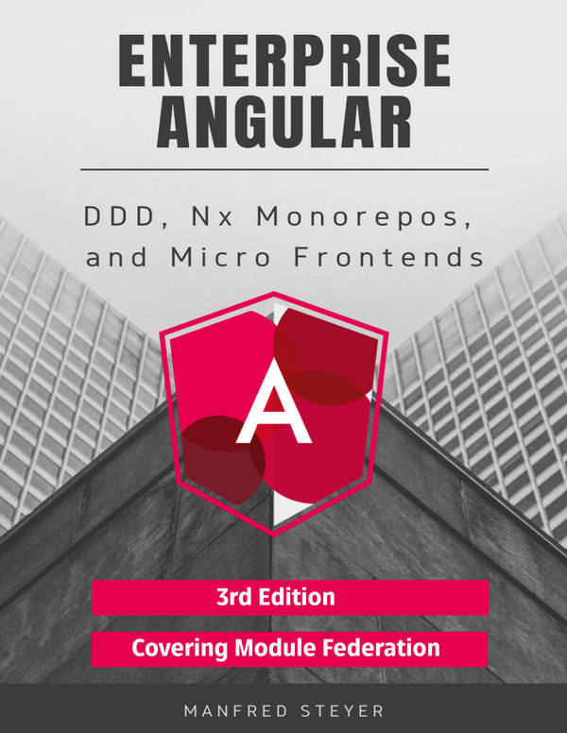
Le Domain Driven Design (DDD)
Domain 1
Domain 2
Shared
Feature
API
Feature
Feature
Ui
Ui
Ui
Ui
Ui
Ui
Sub domain
Sub Domain
Sub Domain
Util
Util
Util
Util
Util
Util
Schéma tiré du livre DDD, Nx Monorepos and Micro Frontends – Manfred Steyer

Slide 7
Architecture Microservice
Système tiers
Database
Database
Database
Database
Couche API en microservices
Couche Frontend
</>
Schéma tiré du livre Building Micro-frontends – Luca Mezzalira

Slide 8
Architecture Micro-frontend
Système tiers
Database
Database
Database
Database
Couche API en microservices
Couche Frontend
</>
</>
</>
</>
</>
Schéma tiré du livre Building Micro-frontends – Luca Mezzalira

Slide 9

Les Principes fondamentaux
Modélisé autour du métier/ domaine
Culture de l’automatisation
Masquer les détails d’implémentation
Grande visibilité
Les Principes de l’Architecture en Microservices
Décentraliser la gouvernance
Isoler les problèmes
Déploiement indépendant
Schéma tiré du livre Building Micro-frontends – Luca Mezzalira

Slide 10
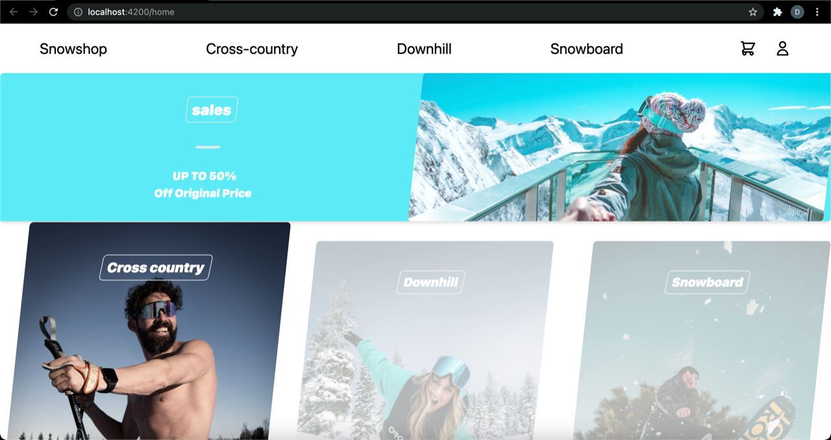
Architecture Micro-frontends – Challenge

Slide 11
Découpage Vertical vs Horizontal
Équipe A
Équipe B
HEADER
HEADER
HEADER (Équipe C)
PRODUCT DETAILS
PRODUCT CAROUSEL
VIDEO PLAYER
PRODUCT DETAILS (Équipe A)
PRODUCT CAROUSEL (Équipe B)
CATALOG
FOOTER
FOOTER
FOOTER (Équipe C)
Découpage Vertical
Découpage Horizontal

Slide 12

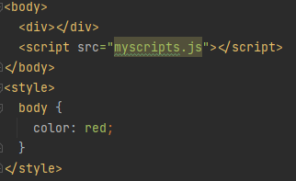


Les modules
Component A
Module 1
Component B
Component C

Slide 13

Webpack

Slide 14

Webpack
Chunk
Module

Slide 15
Webpack
Bundle
Chunk

Slide 16

Webpack Module Federation
Chunk

Slide 17
Webpack Module Federation
Remotes:
Hosts:
const ModuleFederationPlugin = require("webpack/lib/container/ModuleFederationPlugin");
// Other config goes here
plugins: [
new ModuleFederationPlugin({
// For remotes (please adjust)
name: "mfe",
filename: "remoteEntry.js",
exposes: {
'./module': './/src/app/app.module.ts',
},
shared: share({
// Shared libs goes there ...sharedMappings.getDescriptors()
})
}),
sharedMappings.getPlugin()
],
const ModuleFederationPlugin = require("webpack/lib/container/ModuleFederationPlugin");
// Other config goes here
plugins: [
new ModuleFederationPlugin({
// For hosts (please adjust)
remotes: {
'mfe':'mfe@http://localhost:4201/remoteEntry.js'
},
shared: share({
// Shared libs goes there ...sharedMappings.getDescriptors()
})
}),
sharedMappings.getPlugin()
],

Slide 18
Quand l’utiliser ?
Hyper-liens
Très peu
Partage du state, navigation entre les applications
iframes
Module Federation
Oui
Chargement de budles à la demande
Application legacy ou besoin d’isolation très forte
Oui
Beaucoup
Déploiement séparés / mix de technologies
Non
Monolithes
Non
Schéma tiré du workshop Angular ARCHITECTS – Architectures for huge Entreprise Applications with Angular

Slide 19

Exemple avec Angular

Slide 20
Utilisation du Router
const routes: Routes = [
// Others routes goes there
{ path:'mfe',
loadChildren: () => import('mfe/module').then(m => m.MfeModule)
}];
@NgModule({
imports: [RouterModule.forRoot(routes)],
exports: [RouterModule]
})
export class AppRoutingModule { }
declare module 'mfe/module';

Slide 21

Exemple avec Vue

Slide 22
Encapsulation en WebComponent
export class Mfe extends HTMLElement {
connectedCallBack() {
createApp(App).use(router).mount(this)
}
}
customElements.define('mfe-web-component', Mfe);
const ModuleFederationPlugin = require("webpack/lib/container/ModuleFederationPlugin");
// Other config goes here
plugins: [
new ModuleFederationPlugin({
// For remotes (please adjust)
name: "mfe",
library: {type: 'var', name: 'mfe'},
filename: "remoteEntry.js",
exposes: {
'./module': './/src/index.js',
},
shared: ['vue', 'core-js', 'axios']
shared: share({
// Shared libs goes there ...sharedMappings.getDescriptors()
})
}),
sharedMappings.getPlugin()
],

Slide 23
Adaptation du Router
const routes: Routes = [
// Others routes goes there
{ path:'mfe',
component: WrapperComponent,
data: { loadChildren: () => import('mfe/module'),
elementName: 'mfe-web-component' }
}];
@NgModule({
imports: [RouterModule.forRoot(routes)],
exports: [RouterModule]
})
export class AppRoutingModule { }
declare module 'mfe/module';

Slide 24
Composant Wrapper
import { AfterContentInit, Component, ElementRef, OnInit, ViewChild, ViewContainerRef } from '@angular/core';
import { ActivatedRoute } from '@angular/router';
@Component({
template: '<div #vc></div>',
})
export class WrapperComponent implements AfterContentInit {
@ViewChild('vc', { read: ElementRef, static: true })
vc!: ElementRef;
constructor(private route: ActivatedRoute) { }
async ngAfterContentInit(): Promise<void> {
const elementName = this.route.snapshot.data['elementName'];
const loader = this.route.snapshot.data['loadChildren'];
await loader();
const element = document.createElement(elementName);
this.vc.nativeElement.appendChild(element); } }

Slide 25

Exemple avec React

Slide 26
Encapsulation en WebComponent
export class Mfe extends HTMLElement {
connectedCallBack() {
ReactDOM.render(
<React.StritctMode>
<App />
</React.StrictMode>, this)
}
}
customElements.define('mfe-web-component', Mfe);
const ModuleFederationPlugin = require("webpack/lib/container/ModuleFederationPlugin");
// Other config goes here
plugins: [
new ModuleFederationPlugin({
// For remotes (please adjust)
name: "mfe",
library: {type: 'var', name: 'mfe'},
filename: "remoteEntry.js",
exposes: {
'./module': './/src/index.js',
},
shared: ['react', 'react-dom', 'axios']
shared: share({
// Shared libs goes there ...sharedMappings.getDescriptors()
})
}),
sharedMappings.getPlugin()
],

Slide 27

Exemple avec AngularJS

Slide 28
Encapsulation en WebComponent
export class Mfe extends HTMLElement {
connectedCallBack() {
const root = document.createElement('mfe-component');
this.appendChild(root);
angular.bootstrap(root, ['app']);
}
}
customElements.define('mfe-web-component', Mfe);
const ModuleFederationPlugin = require("webpack/lib/container/ModuleFederationPlugin");
// Other config goes here
plugins: [
new ModuleFederationPlugin({
// For remotes (please adjust)
name: "mfe",
library: {type: 'var', name: 'mfe'},
filename: "remoteEntry.js",
exposes: {
'./module': './/src/index.js',
},
shared: share({
// Shared libs goes there ...sharedMappings.getDescriptors()
})
}),
sharedMappings.getPlugin()
],

Slide 29
Merci !

Slide 30




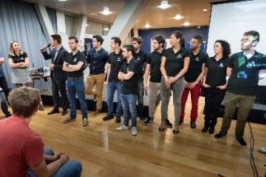
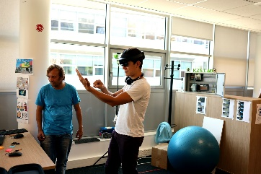

Remerciements
@ManfredSteyer
@MikeZks
Marine Brothier
@Kaizen_Sln

Slide 31



Roti
— Sylvain Dedieu — Vendredi 4 février 2022 10:45
 | Votre feedback nous intéresse !
https://roti.express/r/sc22-017

